Slide 1
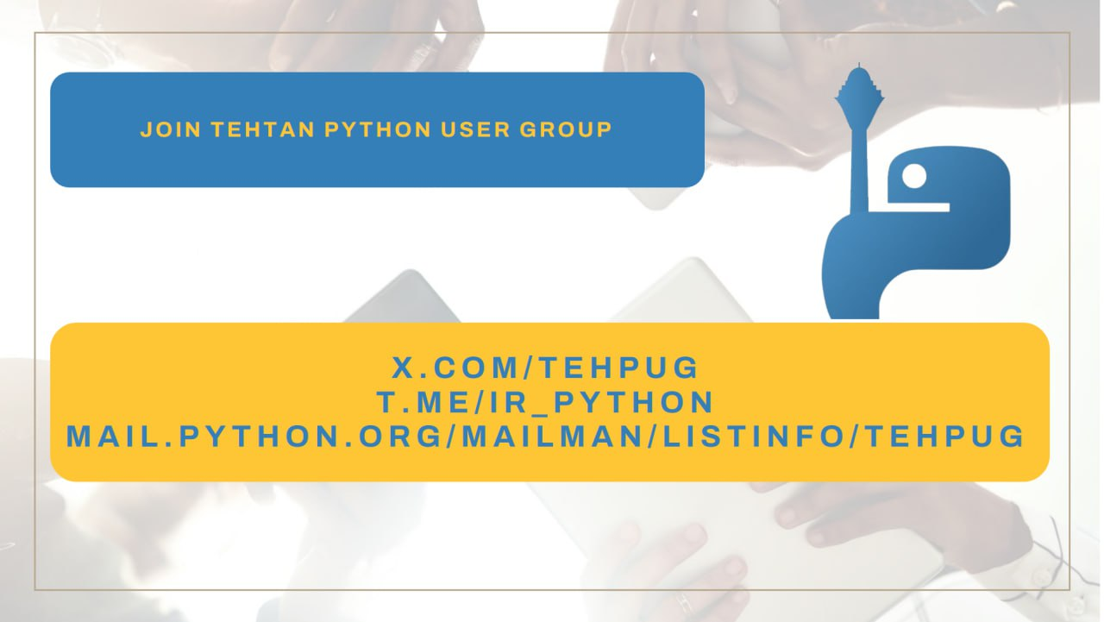

Slide 2
Introduction to PGMQ
Queueing with Postgres and Python

Slide 3
Ali Tavallaie
MLOps Engineer
techbend.io

Slide 4
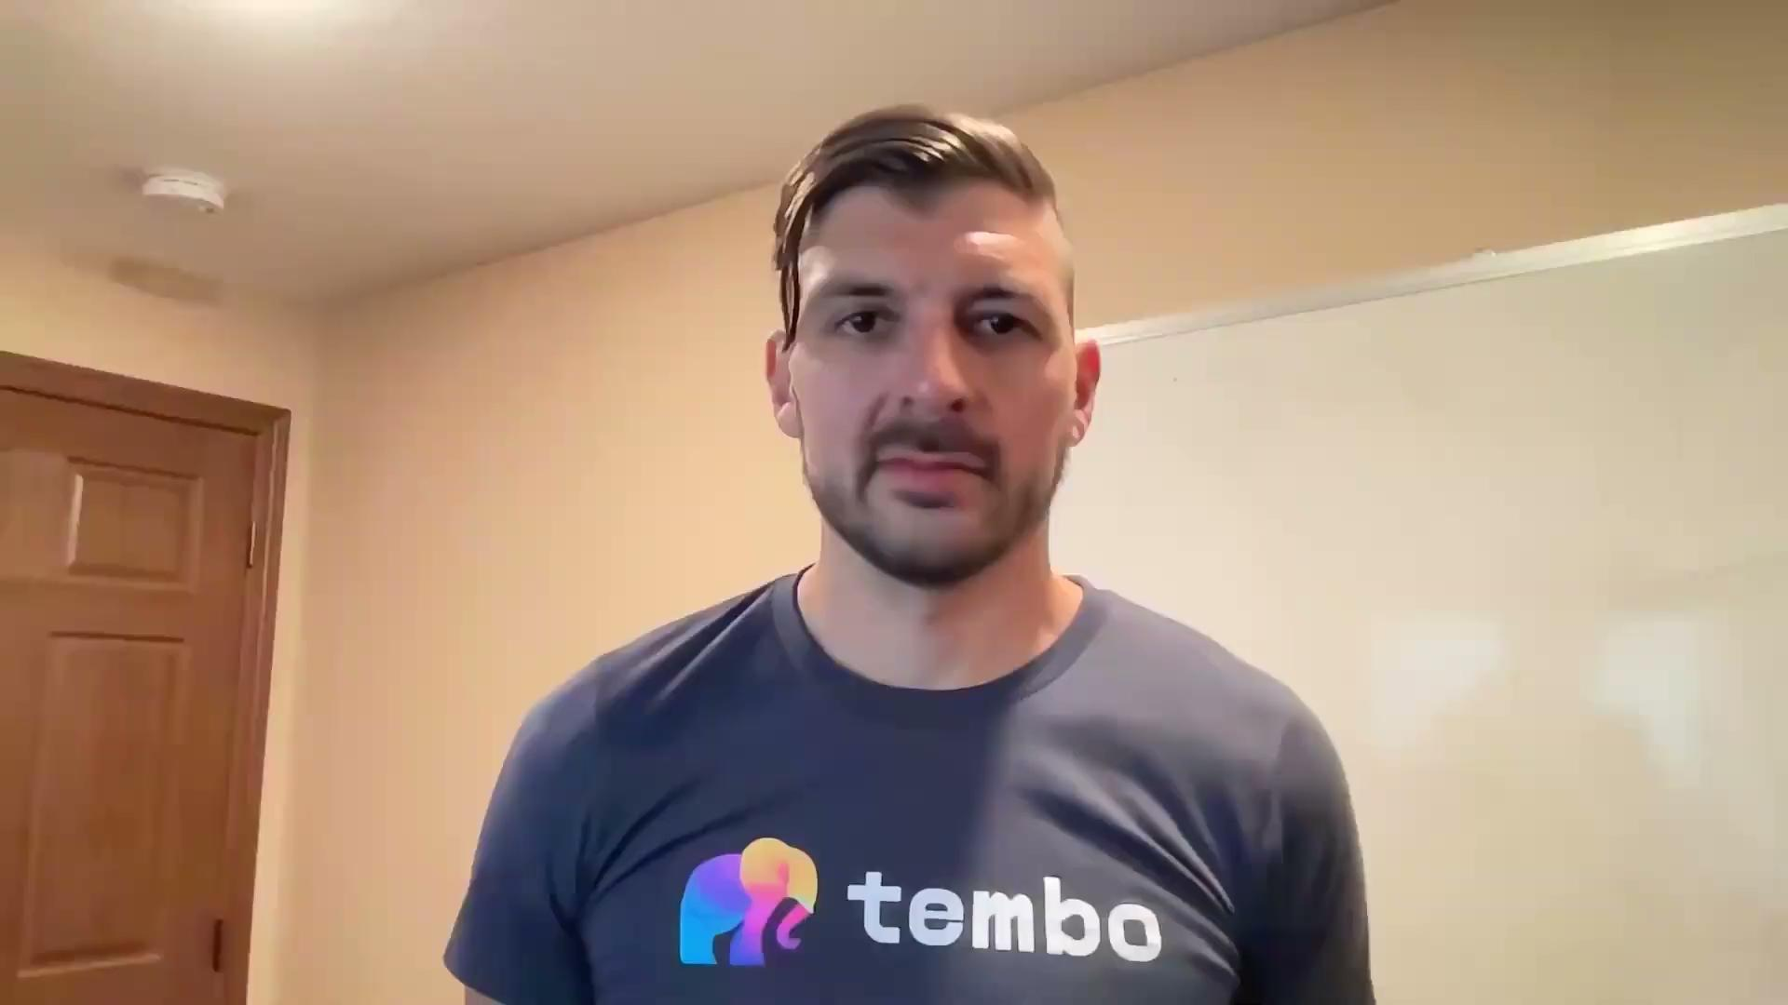

Slide 5

Build Any Application on Postgres,
the Everything Database

Slide 6
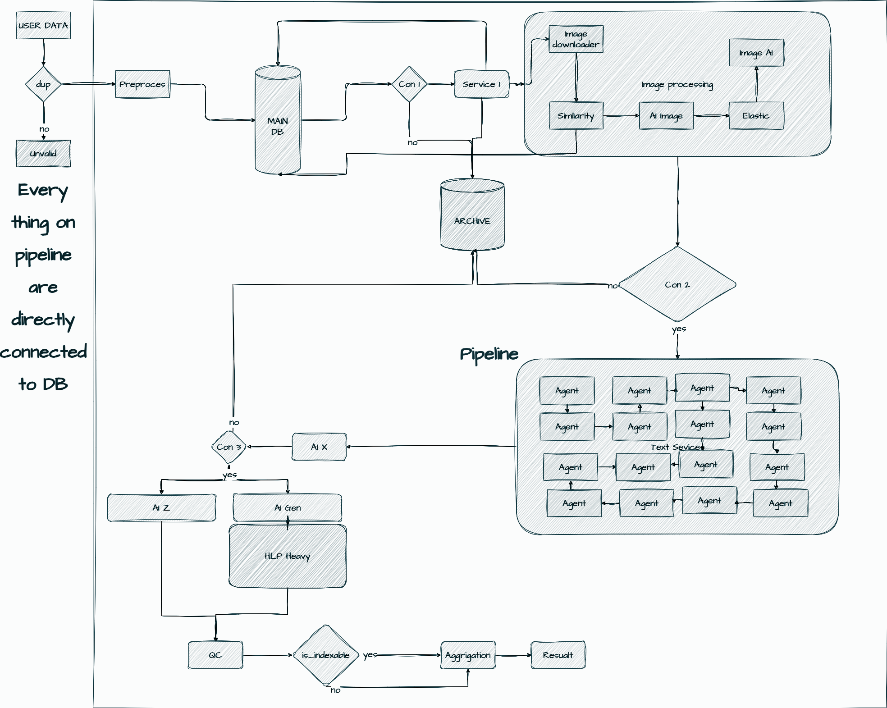
Our Challenge
Multiple microservices for text and image processing.
GPUs are expensive, so tasks must run exactly once.
Needed a lightweight, low-maintenance solution.

Slide 7



Why Not?
Celery
Air Flow
Kafka
Single queue limits flexibility.
Requires Redis/RabbitMQ setup.
Managing workers adds complexity.
Heavy for real-time tasks.
DAG scheduling overhead.
More dependencies and setup.
Built for streaming, not queuing.
Needs complex infrastructure.
Exactly-once delivery is harder.

Slide 8
Our Requirements for a Message Queue
Minimal Dependencies
Exactly Once Processing
Python-Friendly
Reduce maintenance
Avoid duplicating expensive tasks.
Easy integration with our existing codebase.

Slide 9
?
Why PGMQ
Introducing PGMQ

Slide 10
Introducing PGMQ
Definition
Advantages
Postgres-based message queue.
No external dependencies.
Ensures exactly-once delivery.
No extra infrastructure.
Uses existing Postgres.
Handles retries with visibility timeout.

Slide 11
The Core Features That Made the Difference
Simple
Reliable
No external brokers or workers needed
Guarantees exactly-once delivery.
Lightweight
Flexible
Minimal setup, built on Postgres.
Easily adapts to various use cases.

Slide 12
Reliability and Monitoring
Failure Handling
Messages reappear if not processed within the visibility timeout.
Simplifies retry logic and ensures no tasks are lost.
Queue Metrics
Monitor queue length, processing times, and failure rates.
Optimize system performance and scale efficiently.
Transactions
Ensures consistency and simplifies rollback on errors

Slide 13
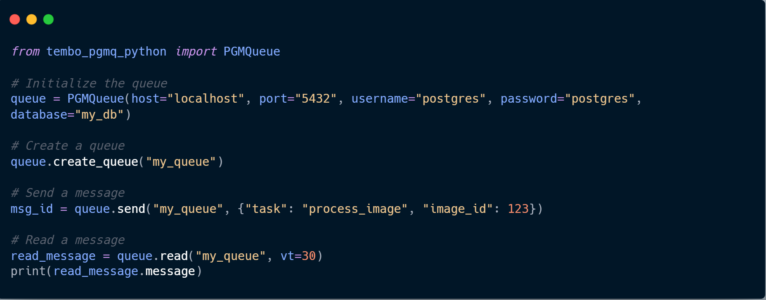

Slide 14
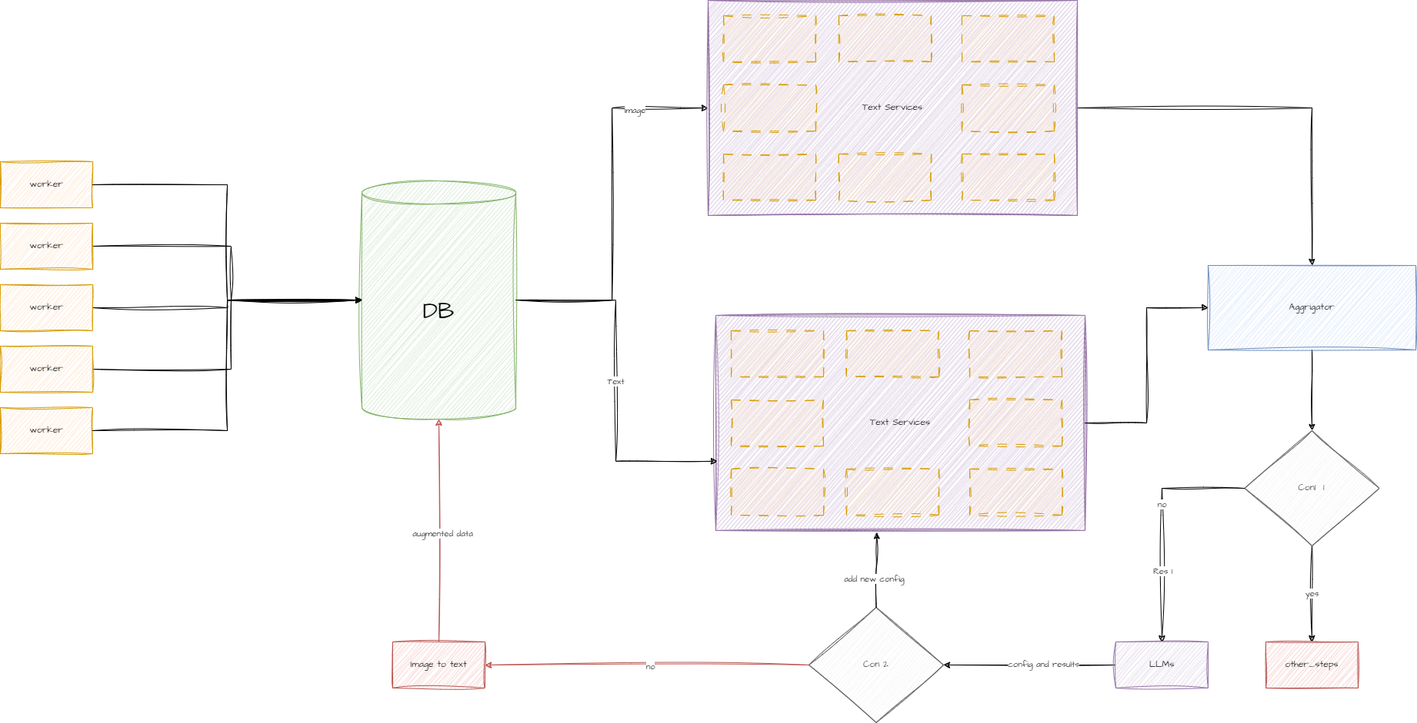
Real-World Example: Processing Pipeline

Slide 15
Thanks!
Do you have any questions?
ali@techbend.io
tembo.io
https://github.com/tembo-io/pgmq
Please keep this slide for attribution

